Slide 1

GCIS-124
Software Development & Problem Solving
12: Data Structures IV

Slide 2
Graphs
In this unit we will learn about a new kind of data structure: the graph.
A graph comprises vertices, each of which holds some kind of data.
Two vertices may be connected by an edge. If so, they are said to be neighbors.
Graphs can be used to model complex data sets representing entities with lots of connections between them including computer networks, airports, highway systems, and so on.
We will be exploring several different aspects of graphs, including:
Graph Terminology
The Graph ADT
Implementing a Graph using Adjacency Lists
Breadth-First Search & Path
Depth-First Search & Path
To begin we will specifically be focusing on graph terminology and implementing a graph using adjacency lists.
A social network is a kind of graph that includes people who are connected based on whether or not they follow each other on the network.
Notes:
Breadth-First Search (BFS) -> Start at a node and explore all neighbor → Use for shortest path
Depth-First Search (DFS) -> Pick one node and keep going down till reach end and backtrack.

Slide 3
Review: Abstract Data
Types
An abstract data type (ADT) defines the behavior of a data structure from the perspective of its user, but does not provide any implementation details.
So far in this course we have explored many different ADTs, including:
Stacks
Queues
Lists
Binary Trees/Binary Search Trees
Heaps
Maps (Dictionaries)
Sets
We have also discussed implementing several of these abstract data types in more than one way, for example:
Node-based vs. array-based queues and lists.
Maps that use trees vs. hashing.
We have also been introduced to the Java Collections Framework (JCF), including:
Java's implementations of many data structures.
Iterable & Iterator
Comparable & Comparator
Collection & Collections
By now we all understand that, not only can each abstract data type be implemented in more than one way...
...but that each implementation has different strengths and weaknesses under different circumstances, e.g. lists...
If you...
...then choose:
- Always Append at the End
- Never Insert or remove in the middle
- Need Random Access
- Know the maximum number of elements
- Always Insert or Remove at head and tail
- Don't need random access
- Don't know the maximum number of elements
Array List
Linked List
Understanding which operations are needed the most frequently will help you choose the most efficient implementation to solve a specific problem.

Slide 4
12.1
Identifying Data Structures
Lots of different data structures can be created by connecting nodes together. We have discussed several of them over the course of the past two units. Examine each picture below and indicate the type of data structure that is being represented. Be as specific as possible with the information given.
9
A
7
5
7
B
6
8
3
8
4
8
C
4
5
9
2
4
9
3
4
6
8

Slide 5
12.1
Identifying Data Structures
Lots of different data structures can be created by connecting nodes together. We have discussed several of them over the course of the past two units. Examine each picture below and indicate the type of data structure that is being represented. Be as specific as possible with the information given.
9
A
7
5
7
B
6
8
3
8
4
8
C
4
5
9
2
4
9
3
4
6
8
LINKED SEQUENCE
(LIST, STACK, QUEUE?)
BINARY TREE
(5 < 6)
BINARY SEARCH TREE
N-ARY TREE
Notes:
An N-ary tree (also called a general tree) is a tree where:
Each node can have 0 to N children
There is no fixed limit like 2
N can be any number (3, 5, 10… even dynamic)
👉 Example:
Binary Search Tree
What it shows:
Root = 5
Left subtree: 3 → 2, 4
Right subtree: 8 → 9
✅ Key Rule (VERY IMPORTANT):
For every node:
Left subtree → values < node
Right subtree → values > node
✔️ Check the tree:
3 < 5 ✔️
2 < 3 ✔️
4 > 3 but < 5 ✔️
8 > 5 ✔️
9 > 8 ✔️
➡️ Everything follows the rule → Valid BST

Slide 6
Node-Based Structures
So far in this course we have spent a lot of time talking about nodes.
As you recall, a node comprises two parts:
A value of some generic type.
A reference to the next node(s).
We have discussed many simple node-based implementations of ADTs including stacks, queues, lists, and binary trees.
A linked list, for example comprises a head node and a tail node, either of which may be null (if the list is empty).
The nodes in a binary tree are slightly more complex.
Each node has a value, a left child, and a right child, either or both of which may be null.
A binary search tree (BST) is a special kind of binary tree with some extra rules:
The values in a non-empty left subtree are always less than the value in the node.
The values in a non-empty right subtree are always greater than the value in the node.
Of course not all trees limit nodes to exactly two children; the nodes in an N-ary tree may contain zero or more children.
data
children
data
data
data
children
children
children
null
data
data
data
children
null
children
...
children
...
Because the nodes in an N-ary Tree may contain zero or more children, children must be stored in a data structure like a list.
All of the other node-based data structures that we have examined are simply specialized versions of an N-ary tree.

Slide 7
A Social Network
Consider your account on the social network of your choice.
There is you...
...and your followers...
...and their followers.
What kind of data structure would you use to represent this system?
How about an N-ary Tree?
Now consider that some of your followers follow each other.
Will an N-ary Tree be sufficient?
No!
In a tree of any kind, children cannot be connected to each other.
Using an N-ary Tree would mean that no two of your followers could ever follow each other.
We will need a new kind of data structure to represent the social network: a graph.

Slide 8
Graphs
Like lists and trees, a graph is conceptually a linked-node structure.
The empty graph, containing no nodes.
A graph containing at least one node with:
A value of some type.
A list of nodes to which it is connected.
In this way, a graph may seem very similar to an N-ary Tree, but the same rules do not apply.
There is no "parent/child" relationship between nodes in a graph.
Any node in the graph may be connected to any other node.
Graphs also use special terminology.
Each node in the graph is referred to as a vertex.
The plural of vertex is vertices.
The connections between vertices are called edges.
Two vertices that are connected by an edge are called neighbors.
Graphs are an ideal data structure for representing real world systems with many-to-many connections between entities, e.g.
Computer networks
Cities connected by highways
Airports connected by airline routes
etc.
A social network is a great example of a graph. Each vertex represents a person in the network. The edges indicate whether or not the people follow each other.

Slide 9
12.2
Graph Identification
Graphs may come in any one of many possible configurations. Look at the diagrams below. Vertices are represented as circles, and edges are lines. Which of the diagrams below represents a graph?

Slide 10
12.2
Graph Identification
Graphs may come in any one of many possible configurations. Look at the diagrams below. Vertices are represented as circles, and edges are lines. Which of the diagrams below represents a graph?
Yes. A linked list is a kind of graph.
Yes. A graph may include only a single edge.
Yes. A graph may only include a single vertex.
Yes. This graph includes 4 vertices and 5 edges.
Yes. There does not have to be a path from any two vertices.
Yes. A binary tree is a kind of graph.

Slide 11
Connected Components
An edge may be uniquely identified by the two vertices that it connects.
For example, the edge connecting vertex A to vertex B may be identified as E_{AB}.
A path is a series of edges that connects two vertices together.
For example, one possible path from vertex A to vertex C in the graph depicted to the right comprises the edges E_{AB} and E_{BC}.
If a path exists between two vertices, they are said to be part of the same connected component within a graph.
A graph may include any number of connected components.
In the graph depicted to the right, vertex D and vertex B are clearly part of the same connected component, because there is at least one path that connects the two.
On the other hand, vertex A and vertex F are clearly not part of the same connected component because there is no path connecting the two.
E
A
B
D
F
G
C
An algorithm that determines whether or not a path exists between two vertices in a graph is called a search.
We will explore three such algorithms throughout this course.

Slide 12




Directed vs Undirected Edges
Consider two friends on Facebook.
Now consider X (sigh).
F
Thank goodness.
G
H
E
C
B
One friend sends the other a friend request. Once accepted, they can both see each other’s timelines.
One user may choose to follow another so that they can see that person’s tweets.
Directed edges are represented in a graph by an arrow on one end or the other of the edge.
If we think of the friends as vertices in a graph, the edge between them is undirected; it works in both directions.
However, the second user does not see the first user’s tweets. The edge between the two users is directed; it only works in one direction.
In the example above, E_{EC}, is directed; the edge can be traversed from E to C but not from C to E. The other edges in the graph are undirected.

Slide 13
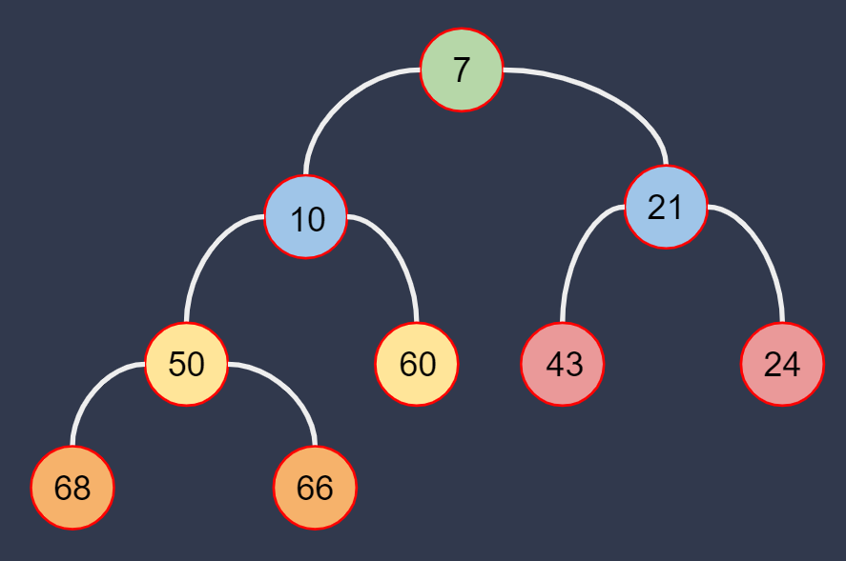
The Graph ADT
The graph abstract data type defines the behavior that a graph must include, without specifying any implementation details.
A graph should provide at least the following behavior:
add(E value) - adds a value to the graph.
contains(E value) - returns true if the value is present in the graph, and false otherwise.
size - returns the number of values in the graph.
connectDirected(E a, E b) - creates a directed connection between the specified two values in the graph.
connectUndirected(E a, E b) - creates an undirected connection between the specified two values in the graph.
connected(E a, E b) - returns true if the two values are connected in the graph, and false otherwise.
Note that the described behavior does not include any references to vertices - that is because there is more than one way to implement a graph!
And the user of the graph does not need to know (or care) about implementation details!
We've seen many data structures that are easier to visualize conceptually using diagrams comprising nodes...
...but by now we also understand that those same data structures may be implemented without using node objects. Graphs are no exception!
7 | 10 | 21 | 50 | 60 | 43 | 24 | 68 | 66

Slide 14
12.3
The Graph Abstract Data Type
Like all of the other abstract data types we have implemented this semester, we will represent the Graph ADT using a Java interface to define (but not implement) it's behavior. The Graph interface should be generic so that the vertices can store any kind of value.
<<interface>> Graph<E>
+ add(value: E) + contains(value: E): boolean + size(): int + connectDirected(a: E, b: E) + connectUndirected(a: E, b: E) + connected(a: E, b: E): boolean
Unless otherwise instructed, use the provided package named "graphs" for all of the code that you write in this unit.
Create a new Java interface named "Graph".
Use the UML diagram to the left as a guide when implementing your Graph interface.
Verify that your interface doesn't contain any syntax errors!
If you're not sure how to fix a problem in your code, raise your hand!

Slide 15
Adjacency Lists
There are a number of different ways to represent a graph. One is referred to as an adjacency list.
Each vertex keeps track of the other vertices to which it is connected in some data structure.
In our graph implementation, no two vertices can be connected with more than one edge. What is the best data structure to efficiently keep track of unique neighbors?
An adjacency list can be diagrammed using a simple table.
The first column lists each vertex in the graph on its own row.
The second column lists the vertices to which that vertex is connected (its neighbors).
Assuming that vertex A is connected to vertex B:
If the edge is directed, then B will appear in A's adjacency list, but not the other way around.
If the edge is undirected, then each vertex will appear in the other's adjacency list.
Let's take a look at an example using the graph depicted to the right.
A
E
B
D
F
G
C
Vertex | Adjacency List
A
B, D
B
A
C
B, D
D
A, C
E
F, G
F
E, G
G
E

Slide 16
12.4
Adjacency Lists
One possible implementation of a graph involves each vertex keeping track of its neighbors in an adjacency list. An adjacency list can be represented using a table. Given the graphs depicted below, fill in the adjacency list for each vertex.
Vertex | Adjacency List
Z
Vertex | Adjacency List
A
X
D
Y
B
G
V
C
U
E
W
F
T

Slide 17
12.4
Adjacency Lists
One possible implementation of a graph involves each vertex keeping track of its neighbors in an adjacency list. An adjacency list can be represented using a table. Given the graphs depicted below, fill in the adjacency list for each vertex.
Vertex | Adjacency List
Z
Vertex | Adjacency List
A
T
W
A
B
X
D
U
W
Y
B
A, C
B
V
Y
C
E, F
G
V
C
W
T, U
D
A, C, G
U
E
X
Y, Z
W
E
C, F
Y
V, X, Z
F
C, E
F
T
Z
X, Y
G
C, D

Slide 18
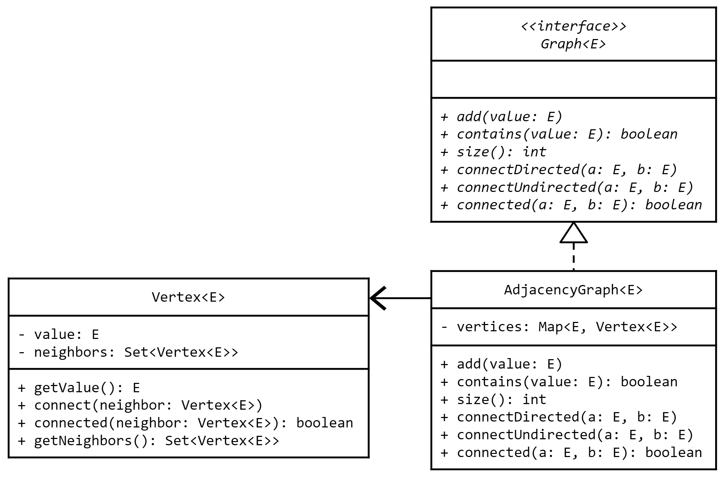
An Adjacency List Implementation
Notes:
Vertices -> Map (Value and Verticx)

Slide 19
An Adjacency List Implementation
The core component of an adjacency graph is the vertex.
The graph itself, maintains a map wherein the entries are value/vertex pairs.
Each vertex maintains a set of the neighbors to which it is connected.
When a value is added to the graph, a new vertex is created and the two are added to the map as the key/value.
Using a hash map provides constant time put and get when adding or retrieving vertices by value.
The fact that vertices are used at all is completely hidden from the user behind the Graph abstraction.
Notes:
The fact that vertices are used at all is completely hidden from the user behind the Graph abstraction.
User of Graph just provides the value

Slide 20
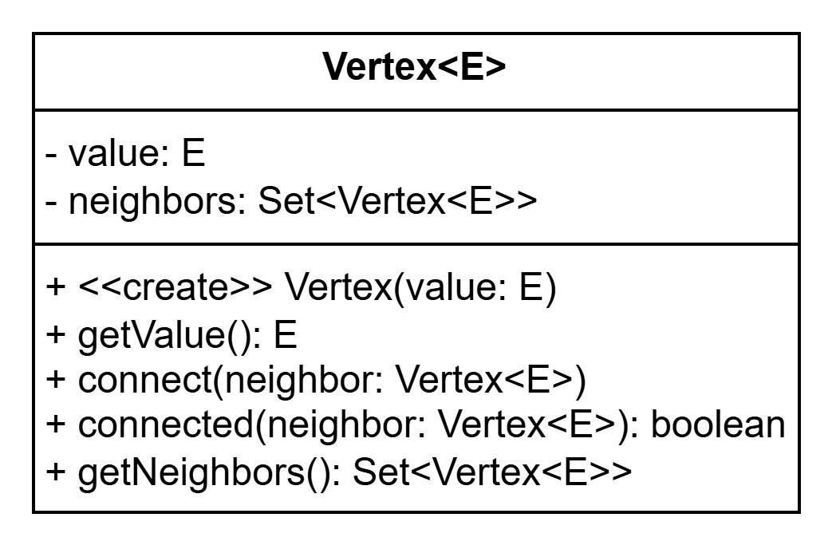
12.5
A Vertex Class
The fundamental building block of an adjacency list implementation of a Graph is the Vertex. Like the nodes used in other node-based structures that we have implemented, a vertex holds a value and keeps track of the other vertices to which it is connected. Let's create a generic Vertex class now.
Create a new Java class named "Vertex".
Use the UML to the left to guide your implementation of your Vertex class.
Remember, Set is a generic data structure, and so a type must be specified for its type parameter. In this case, neighbors is a set of vertices of the same type, i.e. Vertex<E>.
Rename the provided VertexTest and use it to test your Vertex class.
Be careful to run the individual test in order to avoid lots of failures.

Slide 21
12.6
Implementing An Adjacency Graph
Now that we have a working Vertex that keeps track of its neighbors, we can implement the Adjacency-List Graph. It will store vertices in a HashMap, using each vertex's value as the key. Most of the essential functions will be implemented by storing and retrieving vertices from the map.
Create a new Java class named "AdjacencyGraph" that implements the Graph interface.
Use the UML to the left as a guide in implementing your adjacency graph.
For now focus on:
Fields
Constructors
The add, contains, and size methods.
Stub out any remaining methods.
Rename the provided AdjacencyGraphTest and use it to test your implementation.
Some tests will fail because you have only implemented some of the methods in the Graph interface.

Slide 22
12.7
Finish the Adjacency Graph
We have only partially implemented the Adjacency-List Graph. Let's complete it by implementing the remaining methods inherited from the Graph interface. When it is completed, all of the tests in the AdjacencyGraphTest JUnit test should pass.
Open the AdjacencyGraph class and complete the implementation of your adjacency graph.
Implement the connectDirected method.
Implement the connectUndirected method.
Implement the connected method, i.e. return true if a is connected to b. Do not check to see if b is connected to a.
Hint: Use the connected method in the Vertex class.
Test your class using the provided AdjacencyGraphTest.
All tests should now pass.

Slide 23
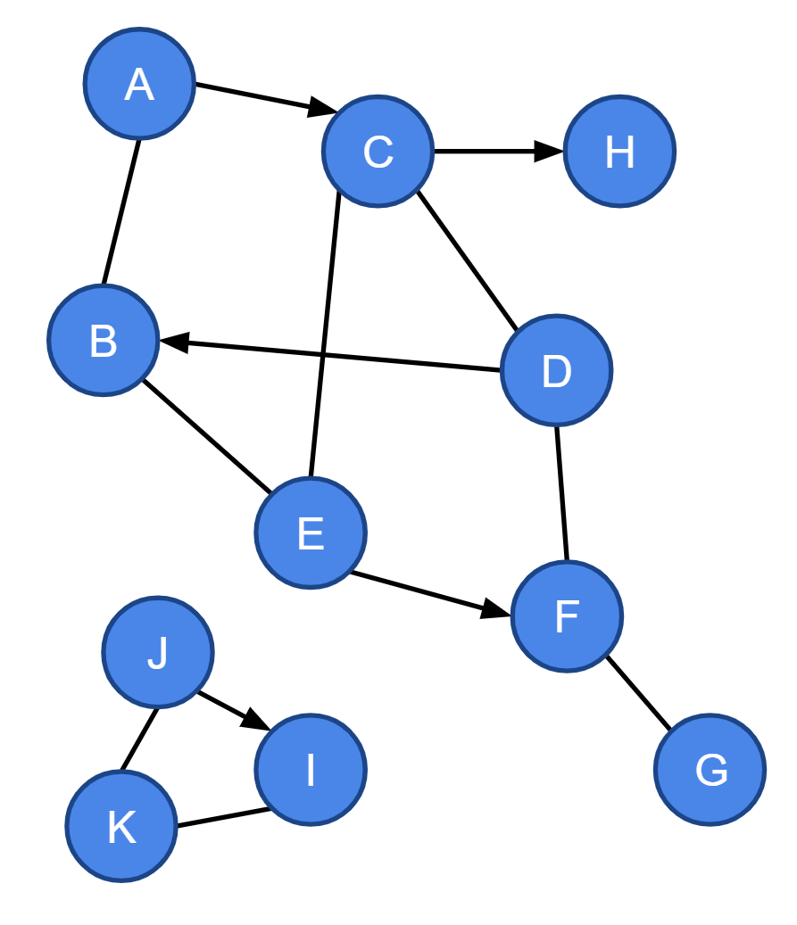
12.8
Building a Graph
We will spend the remainder of this unit implementing several algorithms that work with the data stored inside of a graph. We'll need to build a graph so that we can test the algorithms to see if they are working as expected.
Create a new Java class named "Graphs" and define a static method called makeGraph.
Create an empty AdjacencyGraph of String values.
Write the necessary code to build the graph depicted to the left.
Return the graph.
Test your code with the provided GraphsTest.

Slide 24
A Simple Example
A path is any series of edges that connects two vertices within a graph.
If a path exists between two vertices, then they are in the same connected component.
If no path exists, then they are in different connected components.
A path is represented by listing the vertices along the path, e.g. the path from A to D in the example graph to the right might be A C D or A B D.
Is there a path from A to G in the example graph to the right?
Of course there is! You can see that there are actually multiple possible paths, e.g.
A C D F G
A B E C D F G
You can also state with certainty that there is no path from A to K.
This is easy when the graph is small and you have the ability to look at the entire graph all at once.
But how would a computer determine whether or not a path exists?
A
C
H
B
D
E
F
J
I
G
K
Throughout this course we will examine three different path finding algorithms.

Slide 25
Breadth-First Search
(BFS)
Given some starting vertex S and an ending vertex E, we'd like to determine if a path exists between S and E.
One algorithm for doing this is called a breadth-first search (BFS) and it works like this:
Create a queue and add S to the queue.
As long as the queue is not empty:
Dequeue the next vertex. Let's call it V.
If V is E, you found a path to E! Return true!
If V is not E, then add each of V's neighbors to the queue.
If the queue is empty, then there is no path from S to E. If there were, one of E's neighbors would have added E to the queue. Return false.
Let's try finding a path from F to B in the example graph to the right using BFS.
Begin by adding F to a queue.
We'll cross out each vertex as it is removed from the queue and add its neighbors to the queue.
The search ends when B is found, or the queue is empty.
F
G
H
E
C
B
F
✗
✗
E
G
✗
C
✗
B
H
Queue
In this example, vertex B is found before the queue is empty, and so we know that a path exists!
Notes:
Here the Path should be F and B

Slide 26
12.9
Breadth-First Search "On Paper"
Before trying to implement an algorithm in code it can be useful to run through the steps "on paper" so that you can see how it works. Use the graph depicted below to run each Breadth-First Search (BFS). Your solution should always visit neighbors in alphabetical order.
F
G
G to C
H
E
F to C
C
B
B to G

Slide 27
12.9
Breadth-First Search "On Paper"
Before trying to implement an algorithm in code it can be useful to run through the steps "on paper" so that you can see how it works. Use the graph depicted below to run each Breadth-First Search (BFS). Your solution should always visit neighbors in alphabetical order.
F
G
C
F
G to C
G
✗
H
✗
✗
✗
F
E
G
C
F
C
F
E
F to C
C
B
C
✗
H
B
✗
E
✗
G
H
C
C
H
C
F
B to G
B
✗
✗

Slide 28
Cycles
You may notice something a little odd when running your BFS searches on certain graphs, especially if they do not have any directed edges.
Namely, you may keep seeing the same nodes again and again.
Imagine that you are traversing a graph, following edges from one vertex to the next.
As you continue along your path, you eventually end up back at the node from which you started.
Such a path is called a cycle, and will cause a search algorithm like BFS to visit the same nodes many times over.
In some cases a search might even get stuck in the same cycle forever.
We will need to modify our BFS algorithm so that it keeps track of the vertices that were seen previously.
Only new vertices are added to the queue.
Not all graphs contain cycles. Those that do are cyclic. Those that do not are acyclic.

Slide 29
Breadth-First Search
(BFS)
Given some starting vertex S and ending vertex E, we'd like to determine if a path exists between the two.
But we don't want to get stuck in a cycle and waste a lot of time visiting the same vertices over and over again.
We need a data structure to keep track of previously visited vertices.
We need to efficiently determine if the data structure already contains a vertex.
If so, we can skip it.
If not, we need to efficiently add the vertex to the data structure so that we don't visit it again.
What data structure provides efficient add and get functionality for unique elements?
How about a HashSet?
We'll modify the BFS algorithm to:
Create an empty set as well as a queue.
Add S to both the set and the queue.
Each time we dequeue a vertex V from the queue, we will make sure that each of its neighbors is not already in the set before adding it to both.
These changes should avoid visiting the same vertex more than once!
NEW AND IMPROVED
F
G
H
E
C
B
Set
F
H
C
E
G
B
✗
F
✗
E
✗
C
✗
B
H
F to B
G

Slide 30
12.10
Breadth-First Search Redux
As it is currently written, our BFS algorithm may visit the same vertices over and over again if the graph that it is searching contains cycles. Let's modify the algorithm to use a set to keep track of the vertices that it has visited before so that it does not visit them more than once.
F
G to C
Set
G
H
E
C
F to C
Set
B
B to G
Set

Slide 31
12.10
Breadth-First Search Redux
As it is currently written, our BFS algorithm may visit the same vertices over and over again if the graph that it is searching contains cycles. Let's modify the algorithm to use a set to keep track of the vertices that it has visited before so that it does not visit them more than once.
Set
F
G
C
F
G
G to C
✗
G
F
C
H
E
C
✗
✗
Set
F
E
G
C
F
F to C
✗
C
G
E
B
Set
✗
E
H
B
✗
C
H
✗
E
G
F
B to G
✗
B
C
G

Slide 32
12.11
Adding BFS to the Graph Interface
A Breadth-First Search may be run on any graph, and so it should be part of the Graph interface. Java's default method feature can be used to to add the new method to the interface without immediately breaking any existing implementations.
Open the Graph interface and define a new default method named bfSearch that declares parameters for start and end values and returns a boolean.
Use the provided UML as a guide for your method signature.
Throw an UnsupportedOperationException from this default implementation.
Run the provided BFSearchTest JUnit test.
The tests should run, but will fail when the exception is thrown.
<<interface>> Graph<E>
+ add(value: E) + contains(value: E): boolean + size(): int + connectDirected(a: E, b: E) + connectUndirected(a: E, b: E) + connected(a: E, b: E): boolean + bfSearch(start: E, end: E): boolean

Slide 33
12.12
Begin Implementing BFS
The Breadth-First Search algorithm is fairly straightforward, but it still requires a significant amount of code to implement fully. Let's begin implementing the algorithm in the AdjacencyGraph now by creating all of the data structures that we will need.
Open the AdjacencyGraph class and override the default implementation of bfSearch inherited from the Graph interface.
For now, focus only on the setup for the algorithm.
Get the vertices corresponding to the start and end values from the graph's map of vertices.
Create the queue (java.util.LinkedList) and set (java.util.HashSet).
Add the starting vertex to both.
Return false for now.
Test your partially implemented algorithm using the provided BFSearchTest.
Some of the tests should now pass.

Slide 34
12.13
Complete the BFS Algorithm
Now that the data structures are squared away, we can begin implementing the main BFS loop in the AdjacencyGraph class. This loop will continue visiting vertices until the end vertex is found, or the queue is empty, whichever happens first.
Open the AdjacencyGraph class and navigate to the bfSearch method.
Implement the main BFS loop according to the following algorithm:
As long as the queue is not empty:
Dequeue the next vertex and call it V.
If V is E return true.
Otherwise, for each of V's neighbors N:
If the N is not already in the set:
Add N to both the set and the queue
If the queue is empty, return false.
Test your completed algorithm using the provided BFSearchTest.
All of the tests should now pass.

Slide 35
Building a path
The breadth-first search algorithm that we implemented determines whether or not a path exists between two vertices in the graph, but it doesn't tell us what the path actually is.
It's useful to know that we can get from ROC to LAX, but we can't book the trip if we don't know through which airports to fly!
Recall that, for each neighbor N of vertex V:
If N is not already in the set, this is the first time that we have seen N.
This means that V is N's predecessor along the path (if it exists) - V is the vertex through which we first discovered N.
We will need to make a small change to the BFS algorithm so that it not only keeps track of every vertex, but also its predecessor.
We will use a map instead of a set where the key is the vertex and the value is its predecessor.
In other words, for each neighbor N of vertex V, if N is not already in the map, we will put the N:V pair into the map.
This will allow us to reverse engineer vertices along the path (if it exists) by working backwards through the map.
F
G
H
E
C
Vertex | Predecessor
F
null
B
E
F
G
F
C
E
B
C
H
C
F
E
G
C
B
H
F to B
✗
✗
✗
✗

Slide 36
Constructing a Path
So now that we've filled a map with each vertex and its predecessor along the path, how do we know exactly which vertices actually form the path between F and B?
Using the map, we start at the end of the path (B) and work our way backwards to the beginning (F).
We use each vertex along the path to look up its predecessor.
Each time we retrieve a vertex from the map, we insert it at the front of the path.
We continue until the predecessor is null.
What data structure provides the features we need the most efficiently?
It needs to be iterable and/or offer access by index.
Insert at the front needs to be efficient.
How about a LinkedList?
Vertex | Predecessor
STOP HERE
F
null
E
F
G
F
C
E
START HERE
B
C
H
C
Path
F
E
C
B

Slide 37
12.14
Breadth-First Path
Building a path using BFS is a little more complicated than simply finding one. Once again, it can be a useful activity to run through the steps "on paper" before trying to implement the algorithm Try it now using the searches below. Don't forget to visit neighbors in alphabetical order.
F
Vertex | Predecessor
Vertex | Predecessor
G
H
E
C
B
G to C
F to H
Path
Path

Slide 38
12.14
Breadth-First Path
Building a path using BFS is a little more complicated than simply finding one. Once again, it can be a useful activity to run through the steps "on paper" before trying to implement the algorithm Try it now using the searches below. Don't forget to visit neighbors in alphabetical order.
STOP HERE
F
Vertex | Predecessor
STOP HERE
Vertex | Predecessor
G
G
null
F
null
H
F
G
E
F
E
E
F
G
F
C
START HERE
C
E
C
E
B
B
C
START HERE
H
C
E
F
C
B
H
G to C
F to H
✗
✗
✗
C
✗
✗
✗
✗
✗
G
F
E
G
Path
F
E
C
H
G
F
E
C
Path

Slide 39
12.15
Another Default Method in Graph
The current Breadth-First Search method returns a boolean indicating whether or not a path was found. Let's add another default method to the Graph interface that uses BFS to find and return the values along the path (if it exists).
<<interface>> Graph<E>
+ add(value: E) + contains(value: E): boolean + size(): int + connectDirected(a: E, b: E) + connectUndirected(a: E, b: E) + connected(a: E, b: E): boolean + bfSearch(start: E, end: E): boolean + bfPath(start: E, end: E): List<E>
Open the Graph interface and define a new default method named bfPath that declares parameters for start and end values and returns a java.util.List<E>.
Use the provided UML as a guide for your method signature.
Throw an UnsupportedOperationException from this default implementation.
Run the provided BFPathTest JUnit test.
The tests should run, but will fail when the exception is thrown.

Slide 40
12.16
Begin Implementing BFS-Path
The setup for BFS-Path is very similar to the existing BFS implementation. The only major difference is that we will be using a map to keep track of each visited vertex and its predecessor (instead of a set). Begin implementing the algorithm now by focusing on creating the data structures that you will need.
Open the AdjacencyGraph class and override the default implementation of bfPath inherited from the Graph interface.
Focus on the setup for the algorithm.
Get the vertices corresponding to the start and end values from the graph's map of vertices.
Create the queue (java.util.LinkedList) and add the starting vertex.
Create a predecessor map (java.util.HashMap) and add the starting vertex as the key with a null predecessor.
Return null for now.
Test your partially implemented algorithm using the provided BFPathTest.
Some of the tests should now pass.

Slide 41
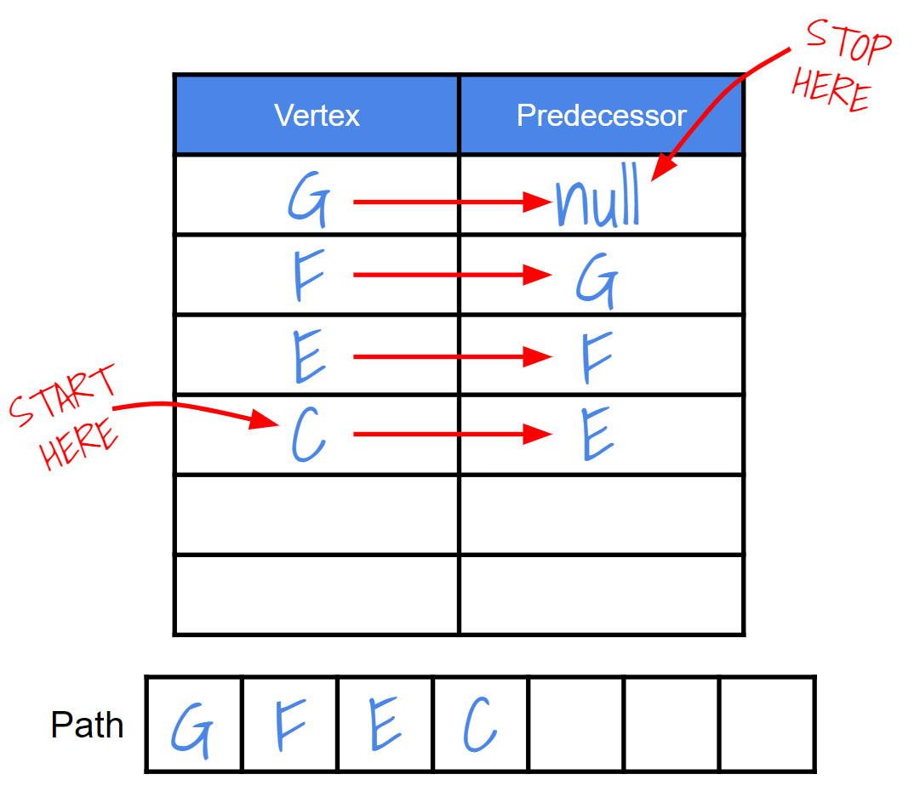
12.17
A Path-Making Helper Function
The most complicated part of the BFS-Path algorithm is using the map of predecessors to build the path in reverse. Implement a helper function that adds values to the path by inserting them at index 0 in a list. Which list implementation should you use?
Open the AdjacencyGraph class and define a private method named "makePath" that declares parameters for a predecessors map and the end vertex and returns a List<E>.
Use the map to build a path according to the following algorithm:
If the map does not contain the end vertex, return null.
Hint: use the containsKey(end) method on the map.
Otherwise:
Make an empty list for the path.
Set the current vertex to end.
As long as current is not null:
Add the current vertex's value to the front of the path.
Use current to retrieve its predecessor from the map.
Set current to the predecessor.
Return the path.

Slide 42
12.18
The Finishing Touches
Now that the hardest part of the BFS-Path algorithm has been implemented, finishing the algorithm should be fairly straightforward. Let's put all of the pieces together and then test the algorithm!
Open the AdjacencyGraph class and navigate to the bfPath method.
Implement the main BF Path loop according to the following algorithm:
As long as the queue is not empty:
Dequeue the next vertex and call it V.
If V is E, break.
Otherwise, for each of V's neighbors N:
If N is not already in the map:
Add N to the queue
Put N (key) and V (value) in the predecessor map.
Call your makePath helper function and return the result.
Test your completed algorithm using the provided BFPathTest.
All of the tests should now pass.

Slide 43
12.19
Breadth-First Path "On Paper"
Z
Vertex | Predecessor
Vertex | Predecessor
Y
W
U
X
V
Z to X
W to Z
Path
Path

Slide 44
12.19
Breadth-First Path "On Paper"
It is important that you be able to demonstrate an understanding of how the BFS-Path algorithm works on your exams, quizzes (and technical interviews!). Practice "on paper" now.
STOP HERE
Z
STOP HERE
Vertex | Predecessor
Vertex | Predecessor
Y
W
Z
null
W
null
Y
Z
U
W
U
U
Y
V
W
V
U
X
U
X
V
W
U
Y
U
START HERE
X
U
START HERE
Z
Y
U
W
X
Y
Z
Z to X
W to Z
✗
✗
✗
✗
✗
✗
✗
✗
✗
✗
Z
Y
V
W
X
U
V
Path
W
U
Y
Z
Z
Y
U
X
Path

Slide 45
Depth-First Search
(DFS)
A search is an algorithm that determines whether or not a path exists between two vertices in a graph.
Breadth-First Search (BFS) is one such algorithm.
BFS uses a queue to search vertices in order based on distance from the starting vertex.
All of the vertices that are one edge away are searched first, then those that are two edges away, and so on.
A Depth-First Search (DFS) is an alternative to BFS.
Rather than explore all of the nodes that are one edge away first, DFS explores deeper and deeper into the graph.
If it arrives at a vertex that does not have any unexplored neighbors, it backtracks along its path only as far as necessary to find a vertex with at least one unexplored neighbor.
A DFS can be implemented using a stack rather than a queue, or through recursion.
A
C
H
B
D
E
F
J
I
G
K
Let's practice depth-first search on this example graph to find a path from A to G.

Slide 46
DFS Illustrated Example
As with BFS, when practicing depth-first search we will always visit neighbors in alphabetical order.
A
If the algorithm arrives at a node with no unexplored neighbors, it will backtrack to the last node with at least one unexplored neighbor.
C
E
Rather than search all of the neighbors of vertex A, DFS will explore deeper into the graph.
B
Like BFS, DFS also uses a set to keep track of previously visited vertices so that we avoid getting trapped in cycles.
D
H
F
The search will continue until all vertices have been explored, or until the end vertex is found.
J
I
G
K

Slide 47
12.20
Depth-First Search
Once again, practicing a new algorithm "on paper" can help gain a better understanding before trying to implement it. Practice using Depth-First Search to perform searches beginning at each vertex listed below below. Remember to always search neighbors in alphabetical order.
Z
Z
Set
Y
W
U
W
Set
X
V
Y
Set

Slide 48
12.20
Depth-First Search
Once again, practicing a new algorithm "on paper" can help gain a better understanding before trying to implement it. Practice using Depth-First Search to perform searches beginning at each vertex listed below below. Remember to always search neighbors in alphabetical order.
Z
Set
Z
U
Z
Y
U
V
W
X
Z
W
Y
V
X
Y
W
U
Set
W
U
V
X
Y
Z
W
Y
W
V
U
Z
X
X
V
Set
Y
U
V
W
X
Z
V
X
Y
U
Z
W
Y

Slide 49
The DFS Algorithm
Like BFS, a depth-first search can be used to determine whether or not a path exists between a start vertex S and an end vertex E.
We will be implementing a recursive implementation of DFS in two parts.
The first part is a helper function that visits a vertex.
It will declare parameters for a vertex V and a set of previously visited vertices.
For each neighbor N of V that is not already in the visited set:
Add N to the visited set.
Visit N (make a recursive call).
The second part is the main DFS method. It will simply:
Create the visited set.
Add S to the visited set.
Call the helper function with S and the visited set.
When the function returns, return true if E is in the set, and false otherwise.
Let's look at an example of performing a depth-first search on the example graph below to find a path from F to B.
Visited Set
F
E
F
G
A
E
B
G
C
C
A
B
A DFS wil search all of the vertices that are reachable from the starting vertex. If the end vertex is in the set after the search is complete, then a path exists!

Slide 50
12.21
Adding a Default DFS Method to Graph
As with the BFS and BFS-Path algorithms, we'll need to add a new method to the Graph interface so that we can attempt a Depth-First Search on any Graph implementation. We should provide a default implementation so as to avoid breaking our existing implementation.
<<interface>> Graph<E>
+ add(value: E) + contains(value: E): boolean + size(): int + connectDirected(a: E, b: E) + connectUndirected(a: E, b: E) + connected(a: E, b: E): boolean + bfSearch(start: E, end: E): boolean + bfPath(start: E, end: E): List<E> + dfSearch(start: E, end: E): boolean
Open the Graph interface and define a new default method named dfSearch that declares parameters for start and end values and returns a boolean.
Use the provided UML as a guide for your method signature.
Throw an UnsupportedOperationException from this default implementation.
Run the provided DFSearchTest JUnit test.
The tests should run, but will fail when the exception is thrown.

Slide 51
12.22
A Recursive DFS Helper Method
Depth-First Search can be implemented using either iteration or recursion. Let's write a recursive implementation beginning with a private helper method that will do most of the work.
Open the AdjacencyGraph class and define a private method named "visitDFS" that declares parameters for a vertex and a set of previously visited vertices.
For each of the vertex's neighbors N that is not already in the visited set:
Add N to the visited set.
Make a recursive call with N and the visited set.
Instead of searching all of the immediate neighbors of a vertex, DFS picks one neighbor, and then one of its neighbors, and so on.

Slide 52
12.23
Put the Finishing Touches on DFS
The recursive visitDFS helper method does most of the work. The main DFS method will only need to create the set of visited vertices and return the final result.
Open the AdjacencyGraph class and override the default implementation of dfSearch inherited from the Graph interface.
Implement the main DFS algorithm as follows:
Get the vertices corresponding to the start and end values from the graph's map of vertices.
Create the set of visited vertices.
Add the start vertex to the visited set.
Call the visitDFS helper method.
Return true if the end vertex is in the visited set, and false otherwise.
Test your algorithm using the provided DFSearchTest.
DFS searches every vertex that is reachable from the start vertex. If a path exists to the end vertex, it will be in the set of visited vertices.

Slide 53
DFS Path Building
As with our initial version of BFS, the current version of DFS tells us whether or not a path exists, but not which vertices are included along the path.
Also like BFS, we will need to modify the current algorithm to construct a path.
The DFS path algorithm declares parameters for a vertex V, the end vertex E, and a set of previously visited vertices.
If V is E, we found a path! Return the path containing only E.
Otherise, for each neighbor N of V that is not in the visited set:
Add N to the visited set.
Make a recursive call to the DFS path function with N, E, and visited.
If the recursive call returns a path, add V to the front of the path and return it.
If none of the neighbors returns a path, return null.
Once again, the path will be built in reverse starting with the end value and working backwards.
The DFS path algorithm does not use a map to keep track of predecessors.
Instead, vertex V makes a recursive call for each of is neighbors N. If the recursive call returns null, that means that there is no path to E that includes N.
If the recursive call returns a non-null path, e.g. a list with at least one other vertex in it, that means that a path to E exists, and it includes N.
Being that V is the vertex through which N was first discovered, then V is also on the path, and so V is added to the path before it is returned.
If none of V's neighbors is on the path to E, then that means that V is not either, and so null is returned (no path).

Slide 54
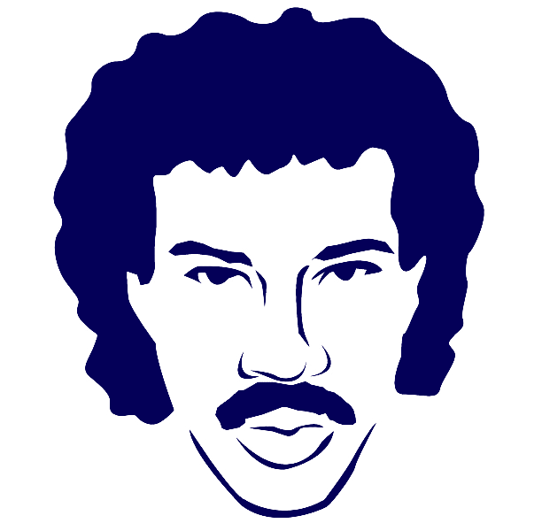
DFS Path Illustrated Example: Y to Z
I wonder if there is a path from Y to Z in this graph?
I will search my first neighbor alphabetically for Z.
I am not Z, so let's search my first neighbor...
Z
Bad news, everyone. Not only am I not Z, I don't have any neighbors left to search. If there is a path, I'm not part of it. I'll return null.
Y
W
U
null
X
V
Still no Z. Let's check my first neighbor...

Slide 55
DFS Path Illustrated Example: Y to Z
Z
Y
W
U
null
X
V
OK, so there is no path through W. Let's try my next neighbor...
null
Not it! And I don't have any neighbors left to search. I'll return null.

Slide 56
DFS Path Illustrated Example: Y to Z
I guess I'll try my other unsearched neighbor....
Z
Samesies.
Y
W
U
null
null
null
X
V
null
Welp, that's it for my neighbors. If there's a path to Z, it ain't through me. I'll return null.

Slide 57
DFS Path Illustrated Example: Y to Z
Hey! Look at that! I found a path to Z! I'll add my value to the front and return the path...
Hello? Is it Z you're looking for? I guess I'll make a path with just my value and return it...
Z
Y
[Z]
W
[Y, Z]
U
null
null
null
X
V
null

Slide 58
12.24
One More Update to Graph
Our current DFS implementation will return true if a path exists, but like the initial BFS implementation it doesn't tell us what the path is. Let's add a default method to the Graph interface that we can override to return the values along a DFS-path (if it exists).
Open the Graph interface and define a new default method named dfPath that declares parameters for start and end values and returns a java.util.List<E>.
Use the provided UML as a guide for your method signature.
Throw an UnsupportedOperationException from this default implementation.
Run the provided DFPathTest JUnit test.
The tests should run, but will fail when the exception is thrown.
<<interface>> Graph<E>
+ add(value: E) + contains(value: E): boolean + size(): int + connectDirected(a: E, b: E) + connectUndirected(a: E, b: E) + connected(a: E, b: E): boolean + bfSearch(start: E, end: E): boolean + bfPath(start: E, end: E): List<E> + dfSearch(start: E, end: E): boolean + dfPath(start: E, end: E): List<E>

Slide 59
12.25
Beginning Depth-First Path
As with the numerous algorithms that we have implemented so far in this unit, we will begin implementing the DFS-Path algorithm by retrieving the start and end vertices and creating the necessary data structures.
Open the AdjacencyGraph class and override the default implementation of dfPath inherited from the Graph interface.
Focus on the setup for the algorithm.
Get the vertices corresponding to the start and end values from the graph's map of vertices.
Create the set of previously visited vertices (java.util.HashSet) and add the starting vertex.
Hint: copy/paste your code from dfSearch.
For now, just return null.
Test your partially implemented algorithm using the provided DFPathTest.
Some of the tests should now pass.
Z
Y
W
U
X
V

Slide 60
12.26
Complete Depth-First Path
Once again, we will be using recursion to implement the DFS-Path algorithm. As with our implementation of DFS, most of the work will be done by a helper function. Let's complete the algorithm now!
Like the DFS algorithm, most of the work done by DFS-Path is handled by a helper function. Open AdjacencyGraph and define a new method called "visitDFPath" that declares parameters for vertices V & E, and a set of previously visited vertices and returns a java.util.List<E>.
If V is E, return a new LinkedList containing only E's value.
Otherwise, for each neighbor N of V that is not already in the visited set:
Add N to the visited set.
Make a recursive call with the neighbor N, E, and the visited set.
If the recursive call returns a non-null path:
Add V's value to the front of the path and return it.
If none of V's neighbors returns a path, then V is not on the path. Return null.
Update dfPath to call visitDFPath and return the result.
Test your algorithm using the provided DFPathTest.
All of the tests should now pass.
Z
Y
W
U
X
V
If a path is found through one of V's neighbors, V is added to the path before it is returned.

Slide 61
BFS vs. DFS
 | Breadth-First Search (BFS) | Depth-First Search (DFS)
Order of Visits
Data Structures Used
Guarantees Shortest Path
Time Complexity
ALL NEIGHBORS FIRST
ONE NEIGHBOR, THEN NEIGHBOR-OF-NEIGHBOR, ETC.
QUEUE, MAP
STACK (RECURSION)
YES (FEWEST EDGES)
NO
O(V + E)
O(V + E)

Slide 62


Summary & Reflection
What is one thing that you wish you knew more about as we move forward?
Graphs
Vertices
Edges
Adjacency Lists
Searches
Breadth-First
Depth-First
Path-Building
Breadth-First
Depth-First
What is one new thing that you learned today?
What one question do you have about today’s class?
Please answer the questions above in your notes for today.

